Slide 1

FFPM 241

Slide 2
FIARAHABANA APOSTOLIKA

Slide 3
FISAORANA SY FIDERANA AN' ANDRIAMANITRA

Slide 4
Sal 138 : 1- 3

Slide 5
FFPM 165

Slide 6

VAVAKA

Slide 7
FANKALAZANA NY TENIN' ANDRIAMANITRA

Slide 8
FOTOANA HO AN'NY ANKIZY SY NY TANORA

Slide 9
Ohabolana

Slide 10
FFPM 226

Slide 11
VAVAKA

Slide 12

VAKITENY
Salamo 68 : 7 - 14 Jaona 8 : 12 - 19 Kolosiana 1 : 9 - 14

Slide 13
FFPM 317

Slide 14
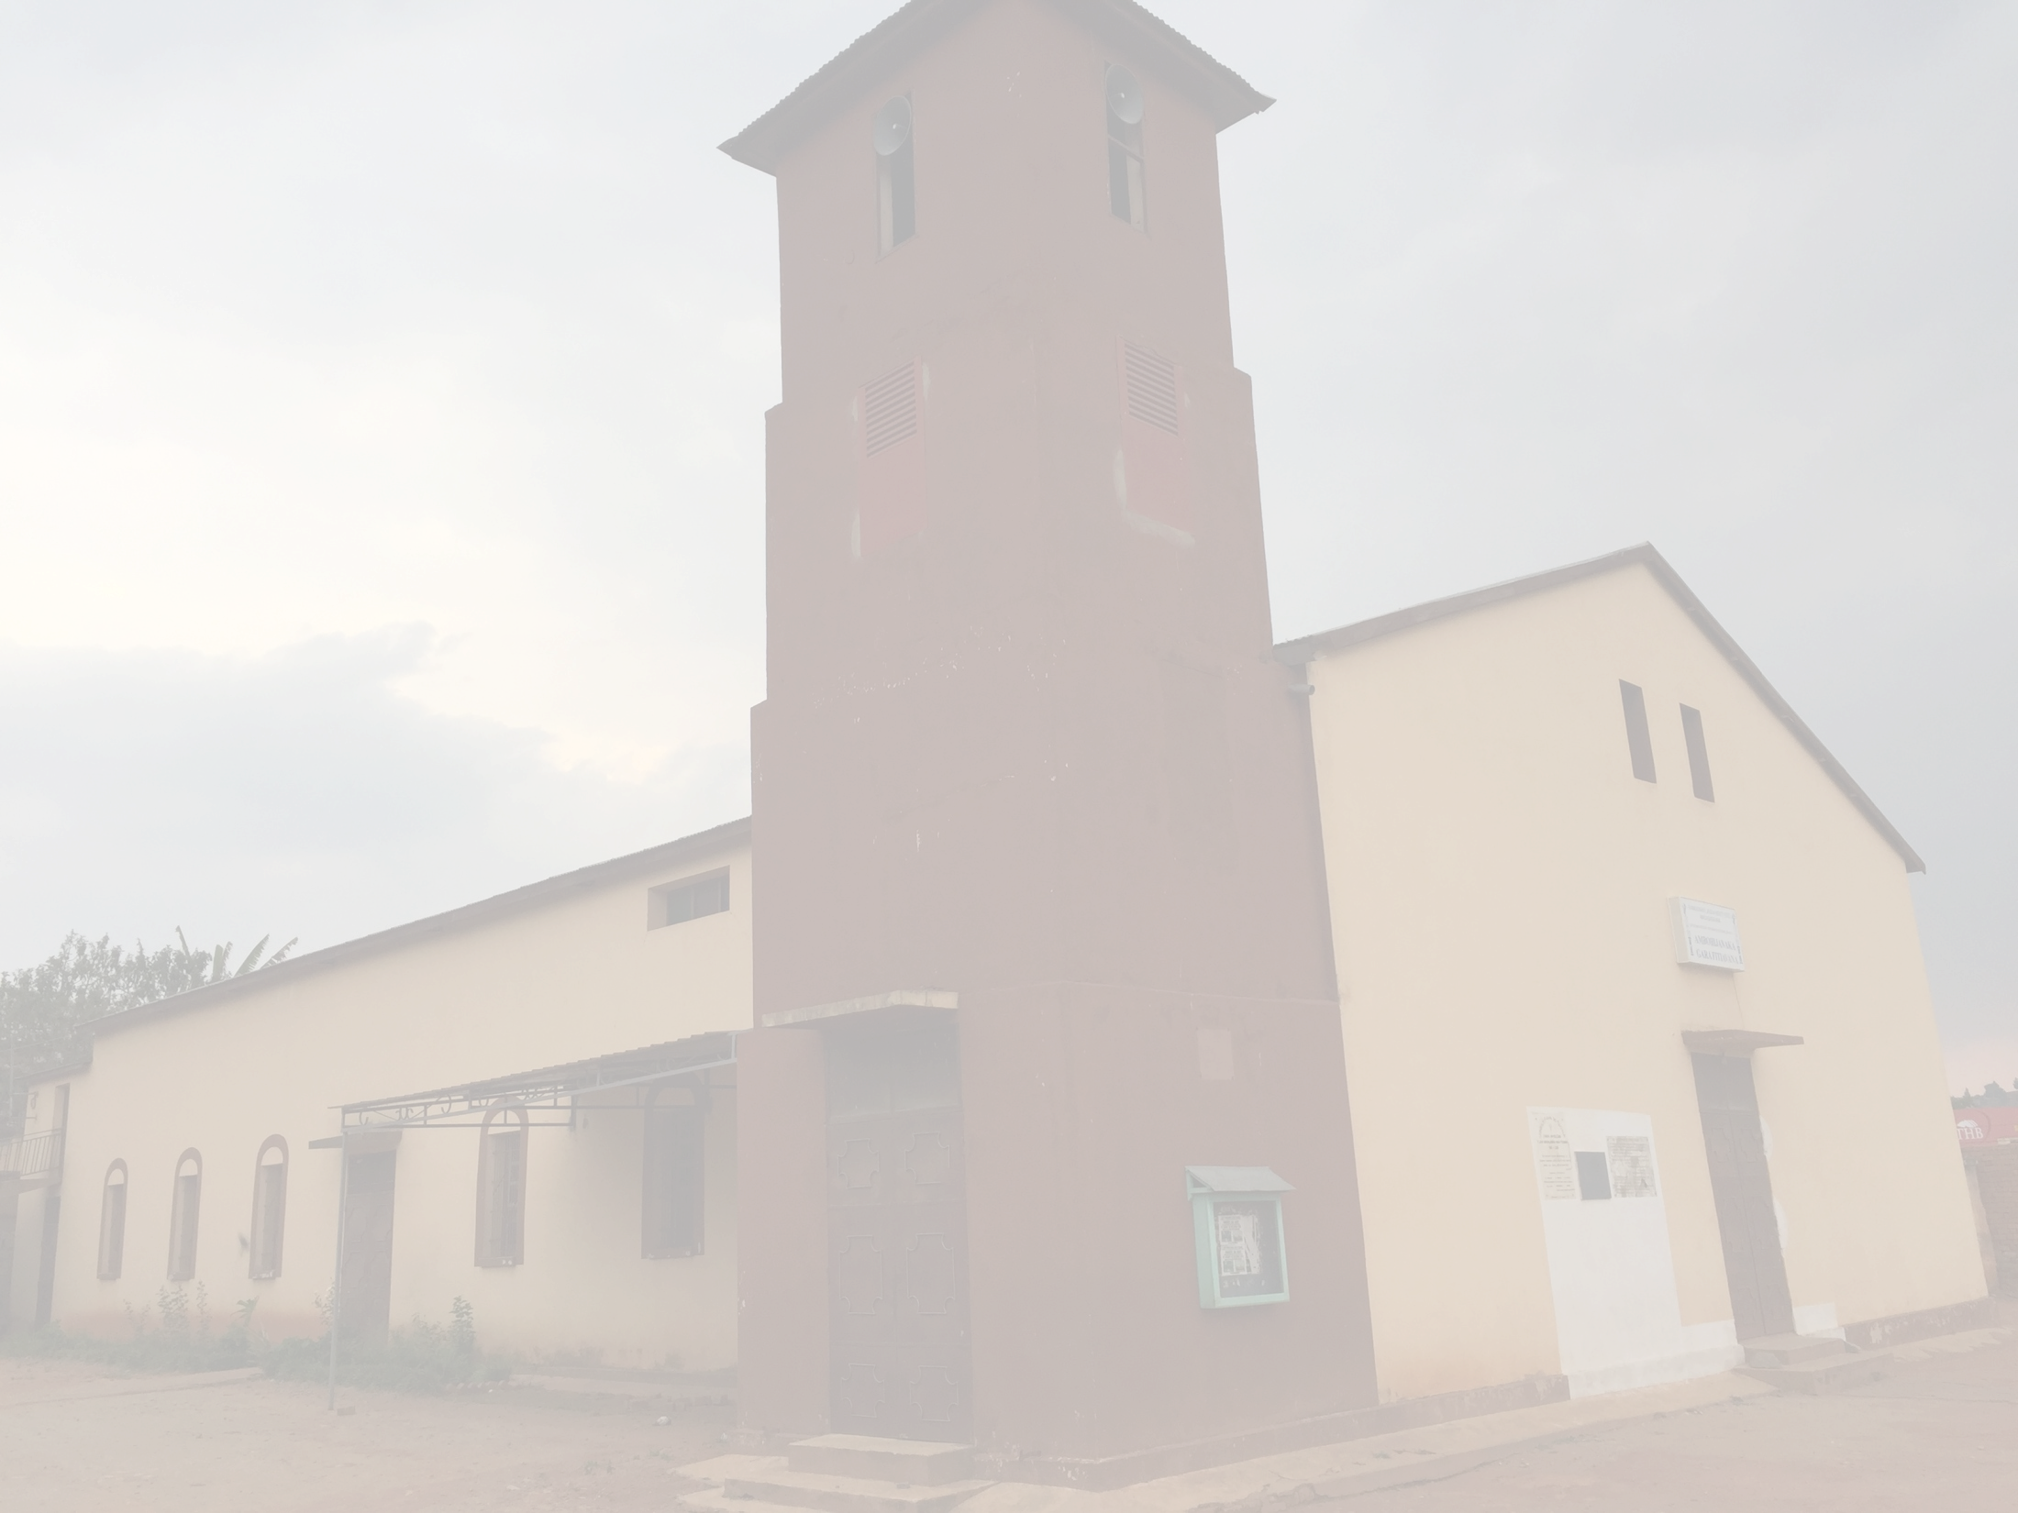
TORITENY

Slide 15

TORITENY

Slide 16
VAVAKA SY RAINAY

Slide 17
FANEKEM-PINOANA FAHATELO

Slide 18
FANEKEM-PINOANA FAHATELO

Slide 19
ASAN' ANDRIAMANITRA

Slide 20
RAHARAHAM-PIANGONANA

Slide 21
RAKITRA

Slide 22
SALAMO 145

Slide 23
FANOLORANA NY RAKITRA

Slide 24
ASA VAVOLOMBELONA

Slide 25
FFPM 297

Slide 26
Fandraisana Mpandray

Slide 27
FF 34

Slide 28
placeholder

Slide 29
ANTEMA 13

Slide 30
Raki-pifaliana

Slide 31
VAVAKA

Slide 32

TSODRANO

Slide 33
FFPM 332

Slide 34
TRINITE

Slide 35
FIRAVANA

Slide 36

Fandraisana Fanasan'ny Tompo

Slide 37
FANEHOANA

Slide 38
ANTEMA 1

Slide 39
ANTEMA 1

Slide 40
antema_1

Slide 41
FANORENANA

Slide 42
VAVAKA

Slide 43
FANAMASINANA

Slide 44
FANASANA

Slide 45
FIZARANA

Slide 46
FFPM 377

Slide 47
FANDRAISANA

Slide 48
FANATI-PISAORANA & FANANGONANA KAPOAKA

Slide 49
FFPM 428

Slide 50
HAFATRA

Slide 51
TSODRANO

Slide 52
TRINITE

Slide 53
FFPM 267

